Slide 1
CLIMATE CHANGE DIPLOMACY
20BCE1630 – Mohamed Ashraf Ali
20BCE1852 – Devarinti Dhapatla Puneeth Reddy
20BCE1855 – Sanjil K C
20BCE1892 – Lenin Vasan
20BCE1978 – Swetha Anbalagan

Slide 2
INTRO AND ABSTRACT
Although India appears to be taking a defensive position in relation to climate change in the international arena, there have been a large number of measures that have been initiated since 1990 within India and these measures collectively are likely to lead to a decoupling of greenhouse gas emissions from energy development and possibly even economic growth.
India's success in renewable energy auctions, in reducing emissions besides its largest commitment to eliminate all single-use plastic in the country by 2022, has enabled it to win accolades globally. Even the Indian private sector is not lagging behind in joining the ranks of leading global companies that have committed to set a scientific target to be carbon negative.

Slide 3
"That leadership was demonstrated at the leaders' climate summit in April where President Joe Biden and Prime Minister Narendra Modi launched the India-US Climate and Clean Energy Agenda 2030 Partnership, a key framework to help our countries meet the goals of the Paris Agreement,"
At CoP26, India pledged to become a 'net zero' carbon emitter by 2070, and announced enhanced targets for renewable energy deployment and reduction in carbon emissions.
A Germanwatch report says carbon dioxide emissions are rising again globally but India's ranking has improved by three points.
India, which has shown global leadership in the fight against climate change, is a critical part of the global climate change solutions.

Slide 4
UNFCC
For almost a quarter-century, the world has placed its faith in international agreements to address the threat of climate change. A binding global treaty, the reasoning goes, is the best way to ensure that greenhouse gas emissions are capped at a level low enough to prevent dangerous climate change. The effort to set emissions limits got off to a good start in 1992, when the United Nations Framework Convention on Climate Change (UNFCCC) was first signed. The UNFCCC has become about as universal as a treaty can be, with over 190 signatories.
So far, India’s stance on climate change has blended genuine concern for the issue with a resolute refusal to consider limiting its own emissions. On the one hand, the Government of India has long expressed its concern over the effects of climate change. It began formulating policies to support renewable energy in its 2008 National Climate Change Action Plan.
The Indian government has stated its desire to dramatically expand production of hydropower, solar and nuclear energy. And developed countries must do everything they can to help shift India’s current reliance on coal to these more sustainable energy sources.
India was represented by Union Minister of Environment and climate change at the 25th session of Conference of Parties under the UN Framework Convention of Climate Change (UNFCC COP 25), in Madrid, Spain on 10 December 2019.

Slide 5
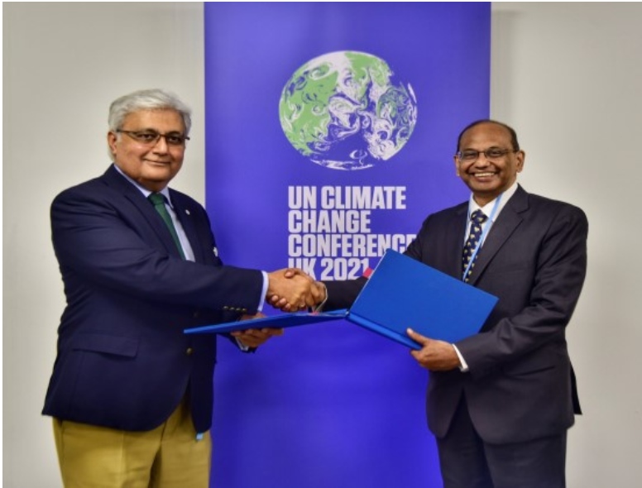
India participation in UNFCCC
The International Solar Alliance (ISA) and the United Nations Framework Convention on Climate Change (UNFCCC) have signed a Memorandum of Understanding (MoU) at COP26 to collaborate and support the Parties in the implementation of ambitious national action in line with global efforts.
Under this agreement, the two institutions will jointly organize a set of activities with the UN Climate Change secretariat to facilitate the implementation of mitigation action in the energy sector, facilitate the implementation of Nationally Determined Contributions, and Long-term Low Emission Development Strategies.
The MoU was signed by Dr. Ajay Mathur, Director General of ISA and Ovais Sarmad, Deputy Executive Secretary of UNFCCC.

Slide 6
PARIS AGREEMENT
India has a comprehensive framework of legal and institutional mechanisms to respond to environmental challenges. It has initiated several climate-friendly measures, particularly in the area of renewable energy (Vipin Chandran & Sandhya, Adaptation and mitigation strategies of climate change, Yojana July1, 2013). India inked Paris deal on October 2, 2016—a landmark pact which calls on countries to combat climate change and limit global temperature rise to well below 2 degrees Celsius.
The Paris climate conference brought into sharp focus the hazards of runaway climate change. India announced its new climate plan, also known as its Intended Nationally Determined Contribution (INDC). It is the world’s third-largest emitter of GHGs—the share stands at around 4 per cent—and is highly vulnerable to impacts of climate change.
The Union Environment Minister announced in December 2016 that India would start preparing for implementing the Paris Agreement from 2017. However, there is no major boost for climate change in Union budget 2017-18. The ministry seems confident to spend large sums in preparing to implement the Paris Agreement that comes into force from 2020.

Slide 7
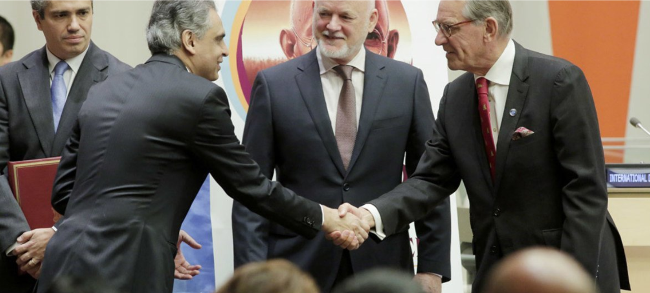
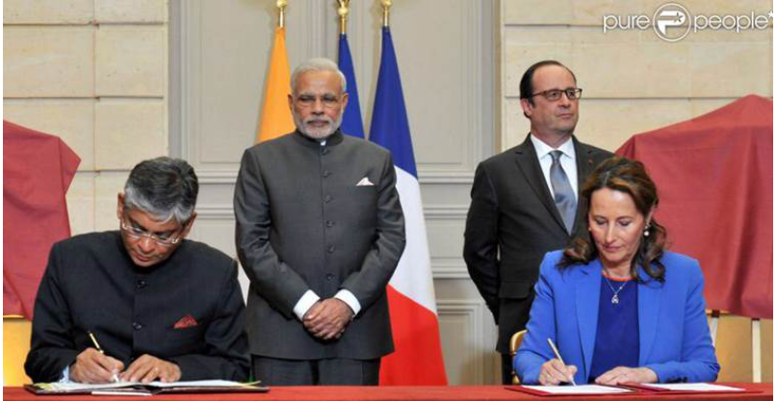
PARIS AGREEMENT
India ratifies the Paris Agreement on climate change. The country's Permanent Representative to the United Nations, Syed Akbaruddin (left), shakes hands with UN Deputy Secretary-General Jan Eliasson while General Assembly President Peter Thomson looks on in a ceremony held at the UN Headquarters on 2 October 2016.
France has welcomed India’s decision to ratify on October 2 the Paris Climate Change agreement aimed at containing global warming by cutting greenhouse gas emissions
French Minister of Environment and Energy Segolene Royal complimented Prime Minister Narendra Modi for deciding to ratify the ambitious pact. The historic Paris Agreement, reached in December last year, will come into force after it is ratified by at least 55 countries, accounting for 55 per cent of global greenhouse gas emissions.

Slide 8

ISA
Paris Declaration on the International Solar Alliance of 30th November 2015. The launch of the International Solar Alliance (ISA) was announced by H.E. Mr. Narendra Modi, the Hon’ble Prime Minister of India and H.E. Mr. Francois Hollande, former Hon’ble President of France on 30th November 2015, at the 21st session of United Nations Climate Change Conference of the Parties (COP-21) in Paris, France. Former UN Secretary-General Ban Ki-moon attended the launch, alongside the Heads of about 120 nations who affirmed their participation in the Alliance to dedicate efforts for promotion of solar energy.
JOURNEY OF ISA/; https://www.isolaralliance.org/about/background

Slide 9
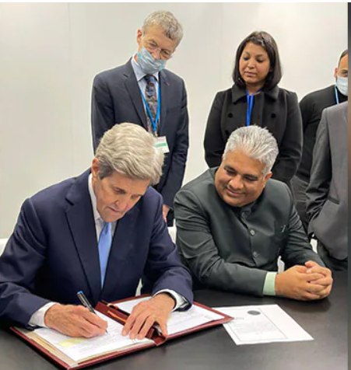
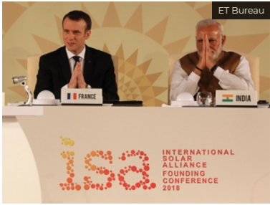
INTERNATIONAL SOLAR ALLIANCE
The United States became the 101st member country of the India-led International Solar Alliance (ISA), as US Special Presidential Envoy for Climate John Kerry signed the ISA framework agreement to catalyse global energy transition through a solar-led approach.
Kerry described the US membership as a major step towards the rapid deployment of solar power, as he formally signed the framework agreement at the COP26 climate summit in Glasgow.
Happy that now USA is formally a part of International Solar Alliance, a visionary initiative launched by PM Shri @narendramodi Ji in 2015 at Paris COP.

Slide 10
MONTREAL PROTOCOL
Introduction
OzoneCell The Vienna Convention for the Protection of the Ozone Layer and the Montreal Protocol on Substances that Deplete the Ozone Layer are the international treaties for the protection of the Ozone layer. India became Party to the Vienna Convention and the Montreal Protocol on 18th March, 1991 and 19th June 1992 respectively.
The Montreal Protocol has been recognized as the most successful international environmental treaty in history. It has been universally ratified and all the 197 countries of the world are Parties to the Vienna Convention and its Montreal Protocol. In the 27 years of its operation with extraordinary international cooperation under the treaty has led to phase-out of production and consumption of several major Ozone Depleting Substances (ODSs) such as Chlorofluorocabons (CFCs), Carbontetrachloride (CTC) and halons globally from 1st January, 2010. The Montreal Protocol has not only contributed to protect the ozone layer but also has reduced Green House Gas (GHG) emissions by about 11 Giga tonnes CO₂ equivalent per year through its ODS phase-out activities so far.

Slide 11
3.The Government of India has entrusted the work relating to the ozone layer protection and implementation of the Montreal Protocol on Substances the Ozone Layer to the Ministry of Environment, Forest and Climate Change (MoEF&CC). The Ministry has established an Empowered Steering Committee (ESC) Chaired by Secretary (EF&CC), which is supported by two standing committees viz. Technology and Finance Standing Committee (TFSC) and the Standing Committee on Monitoring. The ESC is overall responsible for implementation of the Montreal Protocol provisions, review of various policies including implementation options, project approvals and monitoring. The Ministry has set up an Ozone Cell as a National Ozone Unit (NOU) to render necessary services for effective and timely implementation of the Montreal Protocol and its ODS phase-out program in India.
4. India had prepared a detailed Country Program (CP) in 1993 for the phase-out of ODSs in accordance with its National Industrial Development Strategy by accessing funds from financial mechanism of the Montreal Protocol. The CP was updated in 2006. India has proactively phased out the production and consumption of CFCs except use in Metered Dose Inhalers (MDIs) used for treatment of Asthma and Chronic Obstructive Pulmonary Disease (COPD) ailments from 1st August, 2008. Subsequently, the use of CFCs in MDIs has been phased out from December, 2012. India has also completely phased out production and consumption of CTC and halons as of 1st January, 2010.

Slide 12
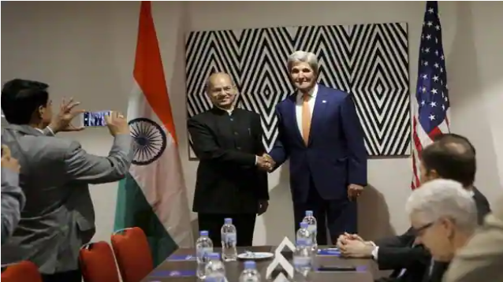
MONTREAL PROTOCOL
John Kerry with Anil Dave at the 28th Meeting of the Parties to the Montreal Protocol on Substances that Deplete the Ozone Layer, in Kigali, Rwanda on Friday.
Kigali (Rwanda): In a possible breakthrough, India and the US on Friday agreed to bring an ambitious amendment to the Montreal Protocol to phase out the climate-damaging Hydrofluorocarbons (HFCs) used in air-conditioners and refrigerators by advancing the “freeze year" by two years to 2028.

Slide 13
INDIA’S ROLE AND RESPONSIBILITY ON CLIMATE CHANGE DIPLOMACT
India is a large economy, market, has the second largest population and it can play an important role in being part of these positive spillover effects.
India needs to move climate change, global warming to the top of its foreign policy agenda. It is in this way that India can draw benefits from its own climate actions.
India’s stance on climate diplomacy has evolved from highlighting the issue of environmental colonialism in the 1990s through the principle of “common but differentiated responsibilities” (CBDR) to pushing for the establishment of an institution like International Solar Alliance in 2015.

Slide 14
ENVIRONMENTAL COLONIALISM
Developed countries blaming developing countries like India and China for the rise in global temperatures. Resisting the pressure from developed countries, the developing countries then put forth the principle of “common but differentiated responsibilities” so that their developmental needs would not be made to pay for the excesses of the developed world.
India’s climate diplomacy needs to construct a development model that takes into account all its needs, including climate change, that is focussed on adaptation, and encourages the responsible engagement from the West on issues like finance and technology.
A country’s economic gain from technological cooperation for the environment can ensure its sustainable engagement with another country, which can, in turn, have a spillover effect on global engagement.

Slide 15
The fall in renewable energy prices, driven by Germany’s domestic programme that basically supported global prices for renewables, is an example.
Therefore, if India can frame its national priorities more accurately and correctly, it can have a more reasonable engagement with the international process in climate change.
For India, large development and growth needs have been a policy priority, with climate seen as a co-benefit. India has made huge strides in lifting millions of people out of poverty while transitioning its economy to a low carbon future. India is investing in clean energy transitions because it makes economic sense, creates jobs and helps in mitigating impacts on climate change, and is one of the few countries on track to meet its Nationally Determined Commitments (NDCs) under the Paris Agreement. India has also stepped up its international climate and clean energy diplomacy by establishing the International Solar Alliance (ISA) in 2014 and the Coalition for Disaster Resilient Infrastructure in 2019. India’s experiences in transitioning to a low-carbon economy can provide replicable examples for other developing countries.

Slide 16
CONCLUSION
It is important for India to prioritize climate change as one of the instruments of its foreign policy. Climate change should not be just considered from the environmental and economic point of view; it also stands to affect strategic considerations. India can start focusing on its neighbourhood to play a constructive role in the area of climate change through its Neighbourhood First policy. Making climate change an integral part of its foreign policy ethics and moving towards climate diplomacy can project India as a sensitive and responsible global leader.
At a time when India is expected to play a proactive role in the security architecture of the Indo-Pacific region, it is important that India maintains cordial relations with its maritime neighbours. At the same time, in order to compete with China, India would need to diversify its relations with other countries. This is necessary in the view of current asymmetry between India and China in economic and strategic domains. For the purpose of diversification, soft power – which includes cultural and historical links – has long been one of India’s instruments of foreign policy.

Slide 17
REFERENCES
https://moef.gov.in/en/division/environment-divisions/montreal-protocol-ozone-cell-oc/introduction/
https://www.isolaralliance.org/about/background
https://climate-diplomacy.org/start
https://unfccc.int/process-and-meetings/the-paris-agreement/the-paris-agreement
https://www.downtoearth.org.in/blog/climate-change/paris-agreement-and-india-s-climate-change-challenges-57000
https://thediplomat.com/2019/12/time-to-practice-climate-change-diplomacy-in-indias-neighborhood/
https://www.drishtiias.com/daily-updates/daily-news-editorials/climate-diplomacy-for-india
https://www.orfonline.org/expert-speak/strengthening-climate-diplomacy-imperative-indian-climate-new-decade/

Slide 18

THANKS!

